Slide 1
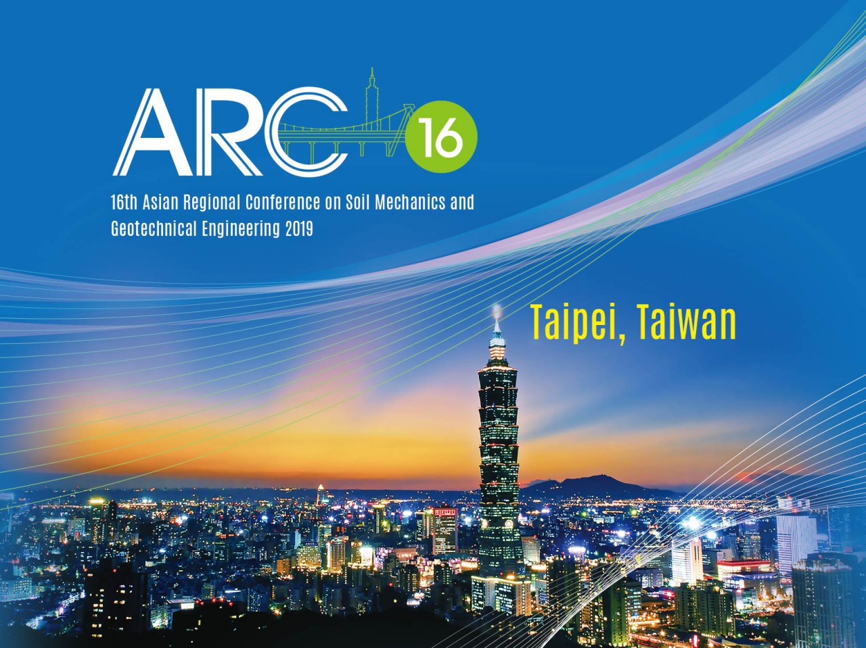

Slide 2
16 ARC hosted by CTGS
Date: October 21-25, 2019
Venue: Taipei Int. Convention Center
(tentative)
Main Theme:
“Geotechnique for Sustainable Developments
and Emerging Market Regions”
18 Subjects will be covered

Slide 3
Regime
International Advisory Board
Local Advisory Board
Organizing Committee
- Chaired by Prof. Chang-Yu Ou (President, CTGS)
Conference Committee
Secretariat

Slide 4
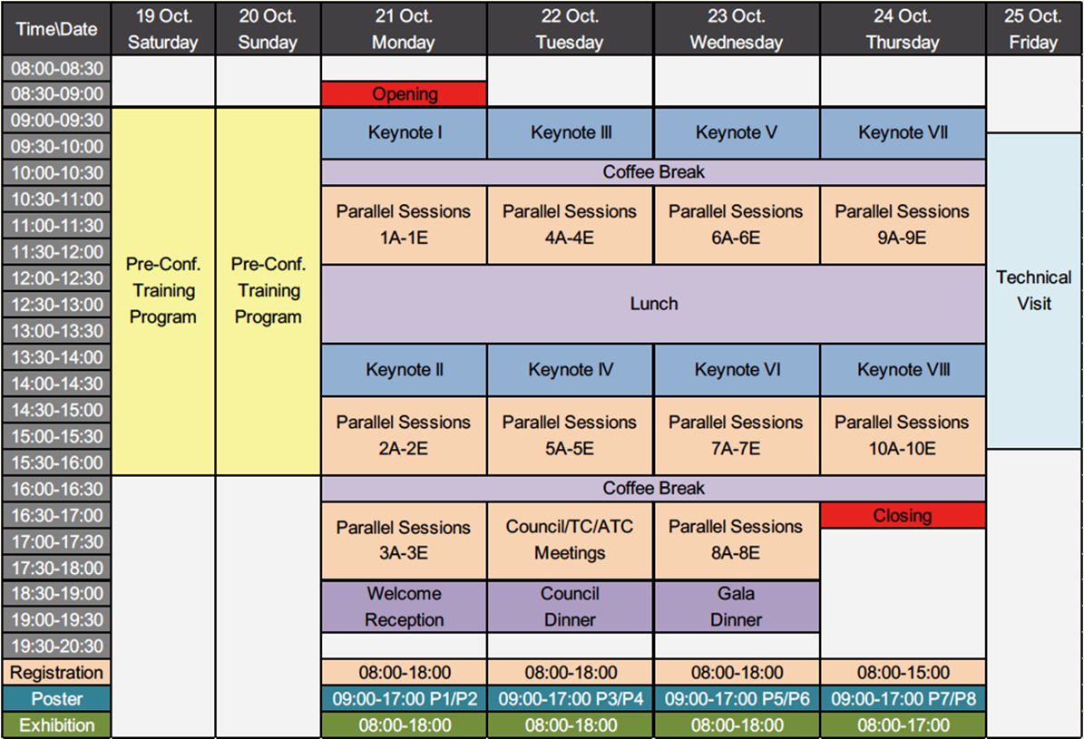
Program
500+ papers
Expected !

Slide 5
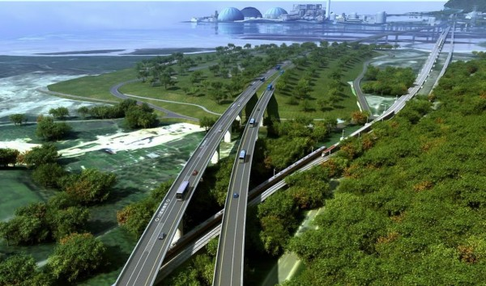

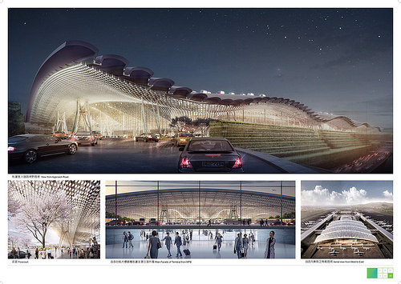
Technical Tours
Taipei Metro Rapid Transit System
Suhua Highway Improvement Project
Tamkang Bridge Project
Tao-Yuan International Airport T3 Project

Slide 6
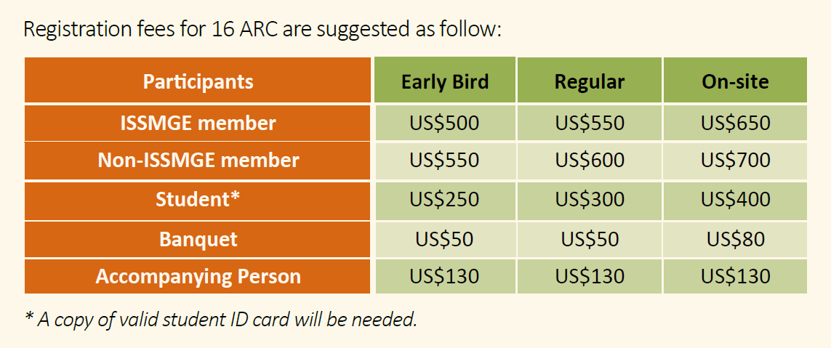
Registration
L.C.C.
guaranteed !
Accommodation

Slide 7
Important Dates
Conf. Web Site - 2nd half year of 2016 1st Bulletin - 2016.10 General Information
2nd Bulletin - 2017.06 Call-for-Paper Announcement and
Invitations for ATC/TC Session Host
Abstract due – 2018.03.31 Abstract acceptance – 2018.05.31 Full paper deadline – 2018.9.30 Full paper reviews – 2018.10.01 ~ 2018.11.30 Notice of comments and revisions – 2019.01.10 ~ 2019.02.15 Final paper received – 2019.03.31

Slide 8
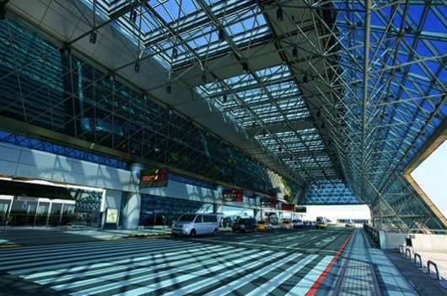
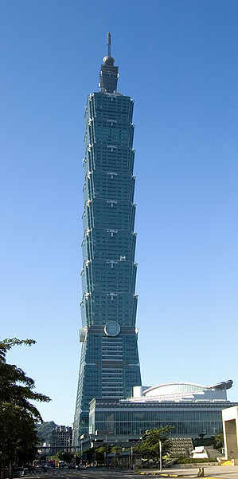
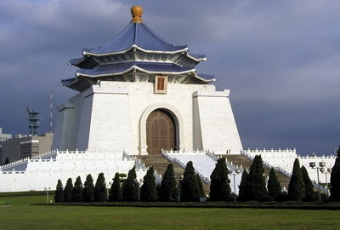



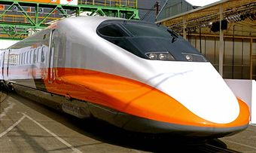

About taipei
Taipei 101
Taipei
Taoyuan
Taoyuan International Airport
National Chiang Kai-shek Memorial Hall
Sun Moon Lake
Sun Moon Lake
National Palace Museum
Kaohsiung
The High Speed Rail allows visitors to travel from Taipei to Kaohsiung in less than 2 hours
Kenting National Park
v
Kenting
One-day Living Circle

Slide 9
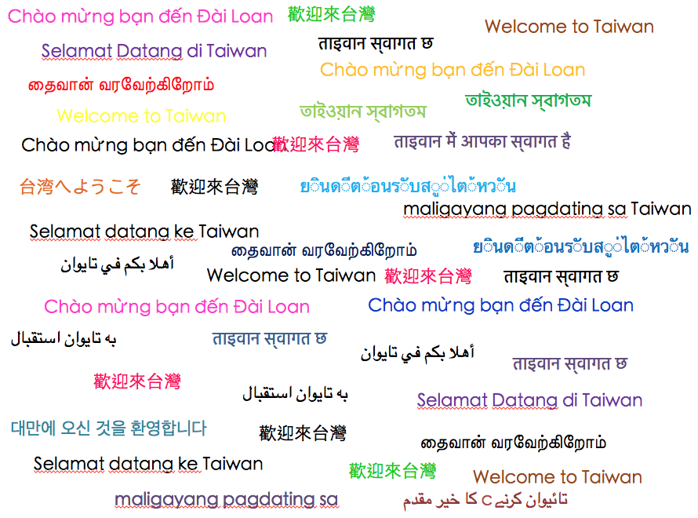
Welcome to TAiwan

